Slide 1

Web Scraping in R

Slide 2
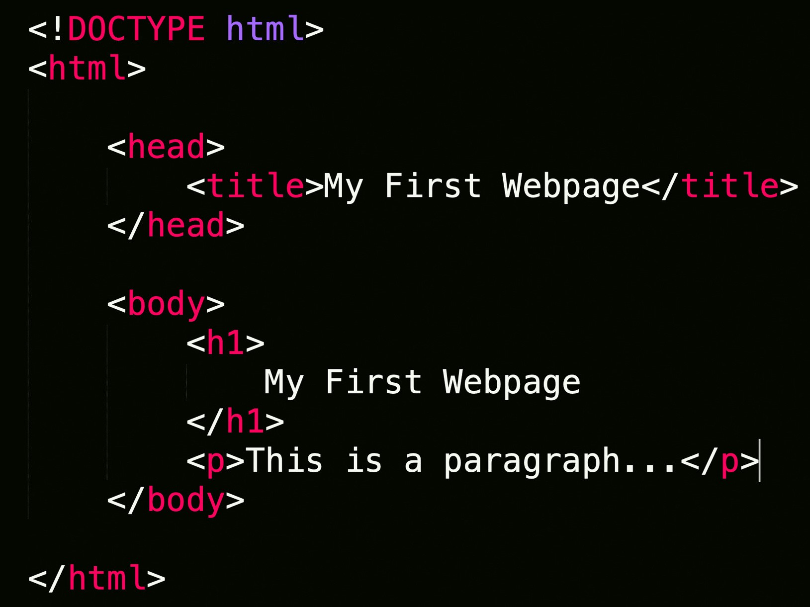
Web Scraping
Extraction of data from a website.
Loads HTML code from URL. User selects which content to keep

Slide 3


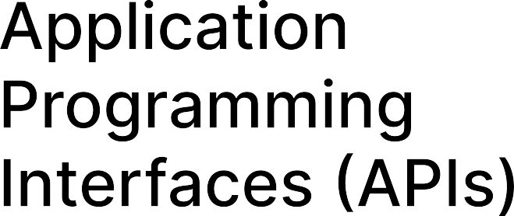
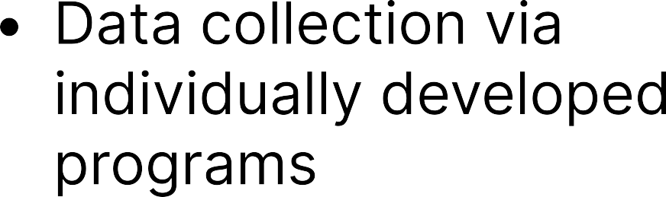






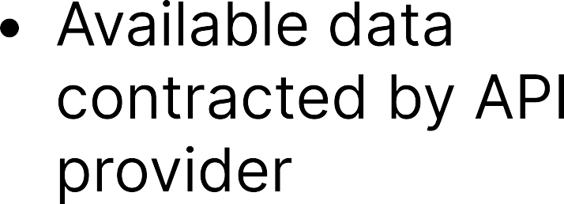
Web Scraping VS APIS

Slide 4
R Packages for Web Scraping
RVest
RSelenium
Most User Friendly. Less flexible
Navigates static webpages.
More complex, but greater flexibility.
Navigates webpage interactively.

Slide 5
Coding Demo
Github Page
Sample code using rvest, RSelenium

Slide 6
Rselenium Installation Instructions
Java
Google Chrome and chromedriver
R packages Rselenium, wdman, netstat
Create folder inside AppData -> Binman. Folder must match version of Chrome installed.
Tutorial video

Slide 7
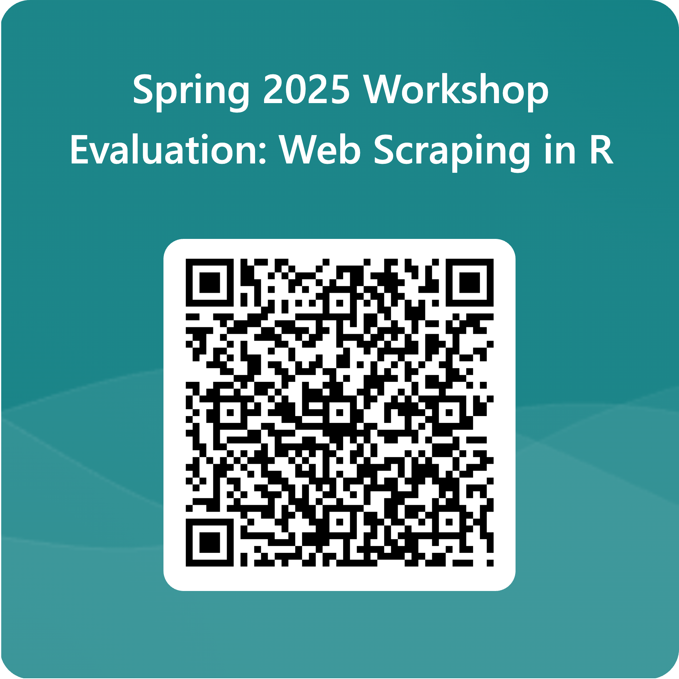
Evaluation

Slide 8
Other CCSS Resources
Programming/Coding Consultation, Data Consultation. For 1v1 or group trainings. Qualitative, Quantitative, Accessing and working with Data. (Python, R, Stata most popular)
CCSS Workshops. Recordings upon request. Email socialsciences@cornell.edu

